Slide 1

An Exploration of Health Care Services/Provider Search & Clinical Services Descriptions on VA.gov
January 2, 2018
Jane Newman, Content Strategist jane.newman3@va.gov

Slide 2
Enterprise Service Search Facets
& Specialty Services Lists

Slide 3

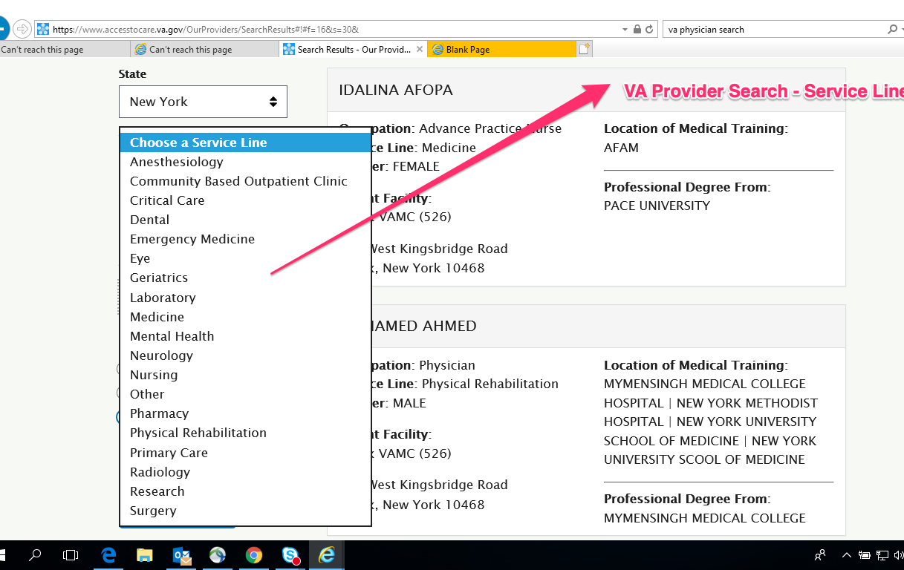
VA Provider Search: accesstocare.va.gov Service Line
PUBLIC-FACING HEALTH CARE SERVICES LISTS | ENTERPRISE LEVEL

Slide 4
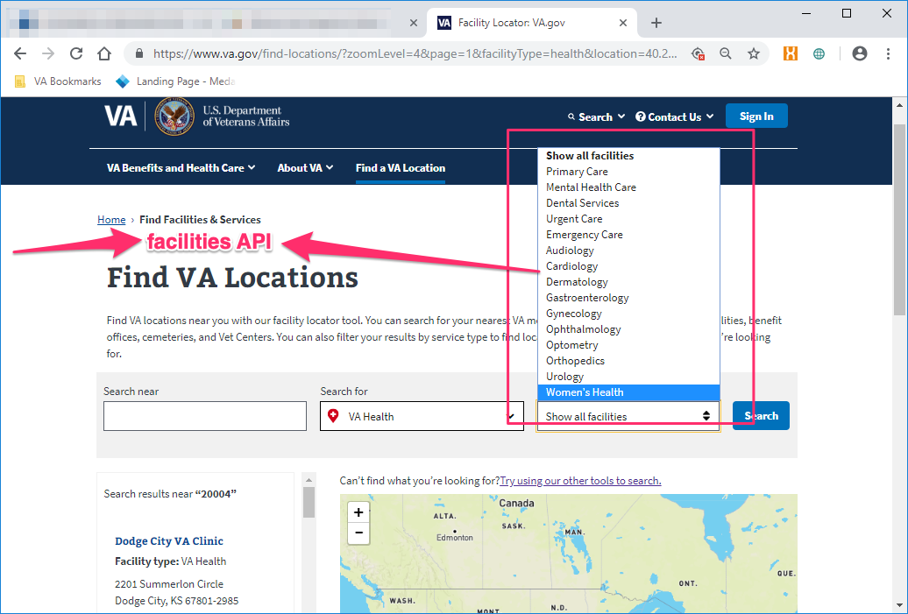
Facility Locator
PUBLIC-FACING HEALTH CARE SERVICES LISTS | ENTERPRISE LEVEL

Slide 5
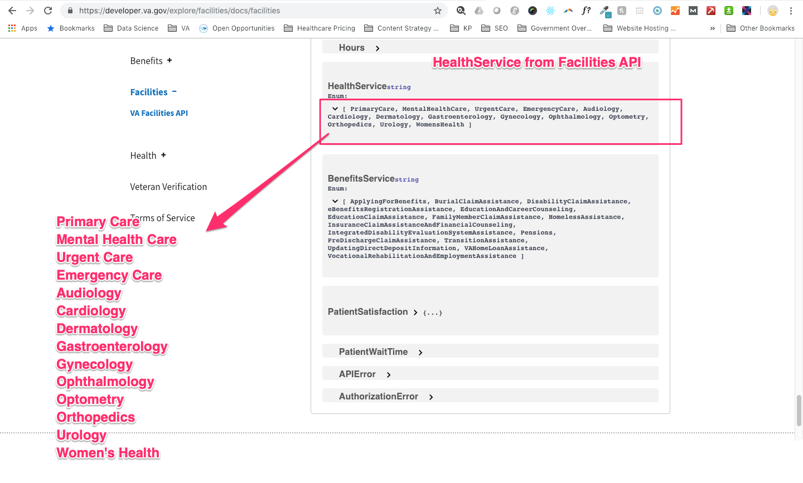
Facilities API: HealthService
PUBLIC-FACING HEALTH CARE SERVICES LISTS | ENTERPRISE LEVEL

Slide 6
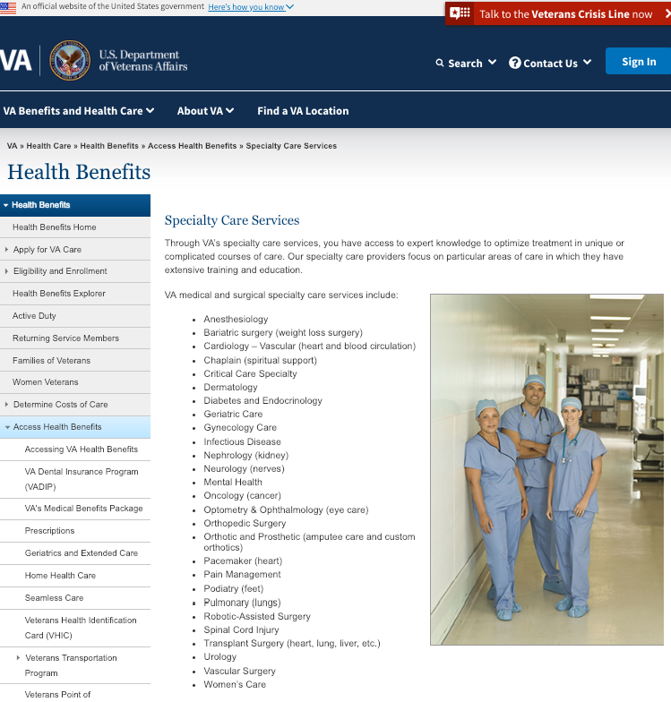
Specialty Care Services (https://www.va.gov/healthbenefits/access/specialty_care_services.asp)
PUBLIC-FACING HEALTH CARE SERVICES LISTS | ENTERPRISE LEVEL
Anesthesiology
Bariatric surgery (weight loss surgery)
Cardiology – Vascular (heart and blood circulation)
Chaplain (spiritual support)
Critical Care Specialty
Dermatology
Diabetes and Endocrinology
Geriatric Care
Gynecology Care
Infectious Disease
Nephrology (kidney)
Neurology (nerves)
Mental Health
Oncology (cancer)
Optometry & Ophthalmology (eye care)
Orthopedic Surgery
Orthotic and Prosthetic (amputee care and custom orthotics)
Pacemaker (heart)
Pain Management
Podiatry (feet)
Pulmonary (lungs)
Robotic-Assisted Surgery
Spinal Cord Injury
Transplant Surgery (heart, lung, liver, etc.)
Urology
Vascular Surgery
Women’s Care

Slide 7
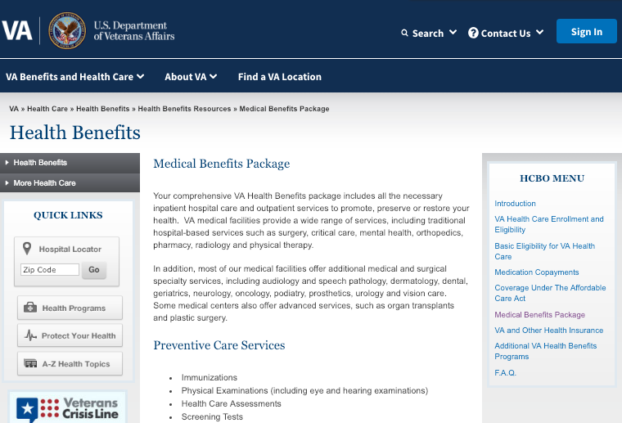
Medical Benefits Package
PUBLIC-FACING HEALTH CARE SERVICES LISTS | ENTERPRISE LEVEL
Immunizations
Physical Examinations (including eye and hearing)
Health Care Assessments
Screening Tests
Health Education Programs
Primary and Specialty Care
Surgical
Mental Health
Substance Abuse
Medical
Surgical
Mental Health
Substance Abuse
Prescription Drugs
Women’s gender-specific health
VA Community Living Centers (VA Nursing Home) Programs
Domiciliary Care
Medical Foster Home
State Veterans Homes
Geriatrics and Extended Care
Adult Day Health Care
Respite Care
Home Health Care
VA’s Family Caregivers Program
Home Telehealth

Slide 8
PUBLIC-FACING HEALTH CARE SERVICES LISTS | ENTERPRISE LEVEL
Same service, alternate name/s
Same service, same name
Access to Care VA Physician Search by Service Line accesstocare.va.gov | Facility API/Services va.gov/facility-locator | Specialty Care Services https://www.va.gov/healthbenefits/access/specialty_care_services.asp | Medical Benefits Package https://www.va.gov/healthbenefits/resources/publications/hbco/hbco_medical_benefits_package.asp
Anesthesiology Community Based Outpatient Clinic Critical Care Dental Emergency Medicine Eye Geriatrics Laboratory Medicine Mental Health Neurology Nursing Other Pharmacy Physical Rehabilitation Primary Care Radiology Research Surgery | Audiology Cardiology Dental Services Dermatology Emergency Care Gastroenterology Gynecology Mental Health Ophthalmology Optometry Orthopedics Primary Care Urgent Care Urology Women's Health | Anesthesiology Bariatric surgery (weight loss surgery) Cardiology – Vascular (heart and blood circulation) Chaplain (spiritual support) Critical Care Specialty Dermatology Diabetes and Endocrinology Geriatric Care Gynecology Care Infectious Disease Mental Health Nephrology (kidney) Neurology (nerves) Oncology (cancer) Optometry & Ophthalmology (eye care) Orthopedic Surgery Orthotic and Prosthetic (amputee care and custom orthotics) Pacemaker (heart) Pain Management Podiatry (feet) Pulmonary (lungs) Robotic-Assisted Surgery Spinal Cord Injury Transplant Surgery (heart, lung, liver, etc.) Urology Vascular Surgery Women’s Care | Physical Examinations (including eye and hearing) Health Care Assessments Screening Tests Health Education Programs Primary and Specialty Care Surgical Mental Health Substance Abuse Medical Surgical Prescription Drugs Women’s gender-specific health VA Community Living Centers (VA Nursing Home) Programs Domiciliary Care Medical Foster Home State Veterans Homes Geriatrics and Extended Care Adult Day Health Care Respite Care Home Health Care VA’s Family Caregivers Program Home Telehealth

Slide 9
Facility A-Z Services Page Audit https://airtable.com/shrVGaJQtG5WXiCtR

Slide 10
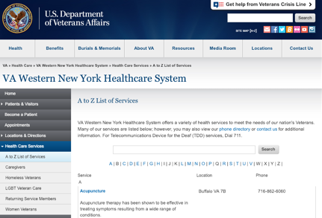
A-Z Services– VA Western NY - Buffalo
FACILITY LEVEL SERVICES

Slide 11
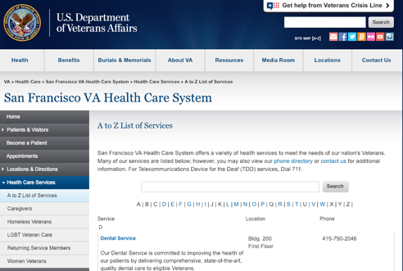
A-Z Services– San Francisco VA HCS
FACILITY LEVEL SERVICES

Slide 12
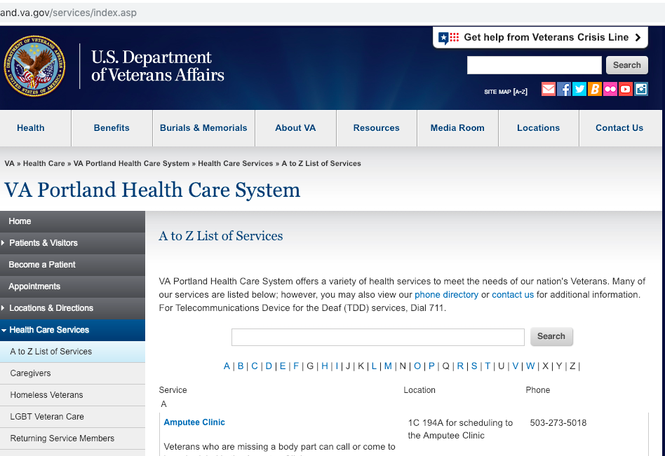
A-Z Services– VAPORHCS
FACILITY LEVEL SERVICES

Slide 13
ACUPUNCTURE
ADULT DAY HEALTH CARE
AGENT ORANGE REGISTRY EXAMS
ALZHEIMERS DISEASE AND DEMENTIA CARE
AUDIOLOGY & SPEECH PATHOLOGY
CANCER CARE ONCOLOGY
CARDIOLOGY
CHAPLAIN
COMMUNITY LIVING CENTER
COMPENSATION AND PENSION EXAMS
DENTISTRY
DIABETES
DIALYSIS
EYE AND VISION CARE
FEE BASIS/FEE SERVICE
FORMER PRISONER OF WAR ADVOCATE
HIV AND AIDS TREATMENT
HOME BASED PRIMARY CARE
HOME TELEHEALTH
HOMEMAKER AND HOME HEALTH AIDE PROGRAM
HOSPICE AND PALLIATIVE CARE
LAB AND PATHOLOGY SERVICES
LGBT PATIENT CENTERED CARE
MAMMOGRAPHY
MENTAL HEALTH
MILITARY SEXUAL TRAUMA COUNSELING
MOVE! WEIGHT MANAGEMENT PROGRAM
NUTRITION AND FOOD SERVICES
OBSTETRICS AND GYNECOLOGY
OCCUPATIONAL THERAPY AND PHYSICAL MEDICINE
OEF OIF OND
ORTHOPEDICS
PHARMACY
PODIATRY
POLYTRAUMA PROGRAM
POSTTRAUMATIC STRESS DISORDER PTSD
PRIMARY CARE
PROSTHETICS AND SENSORY AIDS SERVICE
RADIOLOGY AND DIAGNOSTIC IMAGING
SPINAL CORD INJURY AND DISORDERS
SUBSTANCE ABUSE SERVICES
TELEHEALTH
TRANSPLANT SERVICE
UROLOGY
VA NURSE HELPLINE
VISION REHABILITATION SERVICES
DENTAL SERVICE
EPILEPSY CENTER OF EXCELLENCE
FORMER PRISONERS OF WAR PROGRAM
GASTROENTEROLOGY
GENERAL PRACTICE RESIDENCY PROGRAM
GERIATRICS & EXTENDED CARE
HEALTHY HEART PROGRAM
HOPTEL
HOSPITAL MEDICINE
INFECTIOUS DISEASES CLINIC
LABORATORY MEDICINE SERVICE
LESBIAN, GAY, BISEXUAL & TRANSGENDER (LGBT) PROGRAM
MEDICAL PRACTICE
MENTAL HEALTH
MILITARY SEXUAL TRAUMA (MST)
NEUROINTERVENTIONAL RADIOLOGY
NUTRITION AND FOOD SERVICES
OEF/OIF/OND (NOW CALLED TRANSITION AND CARE MANAGEMENT)
OPIOID TREATMENT PROGRAM
PARKINSON’S DISEASE RESEARCH, EDUCATION AND CLINICAL CENTER
PEER SUPPORT
PETS FOR VETS
PHARMACY
PODIATRY SERVICE
PROSTHETIC TREATMENT CENTER
PSYCHOSOCIAL REHABILITATION AND RECOVERY CENTER (PRRC)
RADIOLOGY
SIMULATION CENTER
SMOKING CESSATION PROGRAM
SOCIAL WORK
TELEPHONE LINKED CARE (TLC)
TRANSITION AND CARE MANAGEMENT
VASCULAR AND ENDOVASCULAR SURGERY
VISUAL IMPAIRMENT SERVICES TEAM (VIST)
WELLNESS PROGRAM
WOMENS COMPREHENSIVE HEALTH CENTER
AMPUTEE CLINIC
AUDIOLOGY AND SPEECH/LANGUAGE PATHOLOGY
BENEFICIARY TRAVEL
CANCER CARE NAVIGATION TEAM
CHAPLAIN SERVICE AND CHAPEL
DENTAL
DIETITIAN
ELIGIBILITY / ENROLLMENT SERVICES
FISHER HOUSE
HOMELESS VETERANS SERVICES AT CRRC
HOSPITAL AND SPECIALTY CARE DIVISION
IMAGING/X-RAY SERVICE
INPATIENT AND EMERGENCY CARE DIVISION
IVF - IN VITRO FERTILIZATION
LESBIAN, GAY, BISEXUAL, AND TRANSGENDER VETERANS
LIBRARY
LOW VISION CLINIC AT PORTLAND VA MEDICAL CENTER
MAMMOGRAMS
MATERNITY BENEFITS
MEDICAL LIBRARY
MENTAL HEALTH AND NEUROSCIENCES DIVISION
MILITARY SEXUAL TRAUMA
MOVE WEIGHT MANAGEMENT
OEF/OIF/OND TEAM
OPERATIVE CARE DIVISION
PAP SMEAR
PATHOLOGY AND LABORATORY SERVICES
PHARMACY
PHYSICAL/OCCUPATIONAL THERAPY - PORTLAND DIVISION
PHYSICAL/OCCUPATIONAL THERAPY - VANCOUVER DIVISION
PODIATRY
PRIMARY CARE
PRIVACY OFFICE
PROSTHETICS
PUBLIC AND CONGRESSIONAL AFFAIRS - VAPORHCS
REHABILITATION - VETERANS RECOVERY HOUSE, A RESIDENTIAL REHABILITATION TREATMENT PROGRAM (RRTP)
REHABILITATION AND LONG TERM CARE DIVISION
RELEASE OF INFORMATION
RRTP
SOCIAL WORK
SPECIALTY CARE
TRANSITION AND CARE MANAGEMENT (TCM) PROGRAM
TTY
VETERAN SERVICE OFFICER SUPPORT AT VAPORHCS
VETERANS JUSTICE OUTREACH (VJO) PROGRAM
VETERANS TRANSPORTATION PROGRAM
VETERANS TRANSPORTATION SERVICE
VIRTUAL LIFETIME ELECTRONIC RECORD (VLER)
WHEELCHAIR CLINIC
WOMEN VETERANS
A-Z SERVICES
www.sanfrancisco.va.gov
www.buffalo.va.gov
www.portland.va.gov
Notes:
here are 3 services lists randomly selected. do you know how many services are consistently names across the board? One. Do you know which one?

Slide 14
ACUPUNCTURE
ADULT DAY HEALTH CARE
AGENT ORANGE REGISTRY EXAMS
ALZHEIMERS DISEASE AND DEMENTIA CARE
AUDIOLOGY & SPEECH PATHOLOGY
CANCER CARE ONCOLOGY
CARDIOLOGY
CHAPLAIN
COMMUNITY LIVING CENTER
COMPENSATION AND PENSION EXAMS
DENTISTRY
DIABETES
DIALYSIS
EYE AND VISION CARE
FEE BASIS/FEE SERVICE
FORMER PRISONER OF WAR ADVOCATE
HIV AND AIDS TREATMENT
HOME BASED PRIMARY CARE
HOME TELEHEALTH
HOMEMAKER AND HOME HEALTH AIDE PROGRAM
HOSPICE AND PALLIATIVE CARE
LAB AND PATHOLOGY SERVICES
LGBT PATIENT CENTERED CARE
MAMMOGRAPHY
MENTAL HEALTH
MILITARY SEXUAL TRAUMA COUNSELING
MOVE! WEIGHT MANAGEMENT PROGRAM
NUTRITION AND FOOD SERVICES
OBSTETRICS AND GYNECOLOGY
OCCUPATIONAL THERAPY AND PHYSICAL MEDICINE
OEF OIF OND
ORTHOPEDICS
PHARMACY
PODIATRY
POLYTRAUMA PROGRAM
POSTTRAUMATIC STRESS DISORDER PTSD
PRIMARY CARE
PROSTHETICS AND SENSORY AIDS SERVICE
RADIOLOGY AND DIAGNOSTIC IMAGING
SPINAL CORD INJURY AND DISORDERS
SUBSTANCE ABUSE SERVICES
TELEHEALTH
TRANSPLANT SERVICE
UROLOGY
VA NURSE HELPLINE
VISION REHABILITATION SERVICES
DENTAL SERVICE
EPILEPSY CENTER OF EXCELLENCE
FORMER PRISONERS OF WAR PROGRAM
GASTROENTEROLOGY
GENERAL PRACTICE RESIDENCY PROGRAM
GERIATRICS & EXTENDED CARE
HEALTHY HEART PROGRAM
HOPTEL
HOSPITAL MEDICINE
INFECTIOUS DISEASES CLINIC
LABORATORY MEDICINE SERVICE
LESBIAN, GAY, BISEXUAL & TRANSGENDER (LGBT) PROGRAM
MEDICAL PRACTICE
MENTAL HEALTH
MILITARY SEXUAL TRAUMA (MST)
NEUROINTERVENTIONAL RADIOLOGY
NUTRITION AND FOOD SERVICES
OEF/OIF/OND (NOW CALLED TRANSITION AND CARE MANAGEMENT)
OPIOID TREATMENT PROGRAM
PARKINSON’S DISEASE RESEARCH, EDUCATION AND CLINICAL CENTER
PEER SUPPORT
PETS FOR VETS
PHARMACY
PODIATRY SERVICE
PROSTHETIC TREATMENT CENTER
PSYCHOSOCIAL REHABILITATION AND RECOVERY CENTER (PRRC)
RADIOLOGY
SIMULATION CENTER
SMOKING CESSATION PROGRAM
SOCIAL WORK
TELEPHONE LINKED CARE (TLC)
TRANSITION AND CARE MANAGEMENT
VASCULAR AND ENDOVASCULAR SURGERY
VISUAL IMPAIRMENT SERVICES TEAM (VIST)
WELLNESS PROGRAM
WOMENS COMPREHENSIVE HEALTH CENTER
AMPUTEE CLINIC
AUDIOLOGY AND SPEECH/LANGUAGE PATHOLOGY
BENEFICIARY TRAVEL
CANCER CARE NAVIGATION TEAM
CHAPLAIN SERVICE AND CHAPEL
DENTAL
DIETITIAN
ELIGIBILITY / ENROLLMENT SERVICES
FISHER HOUSE
HOMELESS VETERANS SERVICES AT CRRC
HOSPITAL AND SPECIALTY CARE DIVISION
IMAGING/X-RAY SERVICE
INPATIENT AND EMERGENCY CARE DIVISION
IVF - IN VITRO FERTILIZATION
LESBIAN, GAY, BISEXUAL, AND TRANSGENDER VETERANS
LIBRARY
LOW VISION CLINIC AT PORTLAND VA MEDICAL CENTER
MAMMOGRAMS
MATERNITY BENEFITS
MEDICAL LIBRARY
MENTAL HEALTH AND NEUROSCIENCES DIVISION
MILITARY SEXUAL TRAUMA
MOVE WEIGHT MANAGEMENT
OEF/OIF/OND TEAM
OPERATIVE CARE DIVISION
PAP SMEAR
PATHOLOGY AND LABORATORY SERVICES
PHARMACY
PHYSICAL/OCCUPATIONAL THERAPY - PORTLAND DIVISION
PHYSICAL/OCCUPATIONAL THERAPY - VANCOUVER DIVISION
PODIATRY
PRIMARY CARE
PRIVACY OFFICE
PROSTHETICS
PUBLIC AND CONGRESSIONAL AFFAIRS - VAPORHCS
REHABILITATION - VETERANS RECOVERY HOUSE, A RESIDENTIAL REHABILITATION TREATMENT PROGRAM (RRTP)
REHABILITATION AND LONG TERM CARE DIVISION
RELEASE OF INFORMATION
RRTP
SOCIAL WORK
SPECIALTY CARE
TRANSITION AND CARE MANAGEMENT (TCM) PROGRAM
TTY
VETERAN SERVICE OFFICER SUPPORT AT VAPORHCS
VETERANS JUSTICE OUTREACH (VJO) PROGRAM
VETERANS TRANSPORTATION PROGRAM
VETERANS TRANSPORTATION SERVICE
VIRTUAL LIFETIME ELECTRONIC RECORD (VLER)
WHEELCHAIR CLINIC
WOMEN VETERANS
A-Z SERVICES
www.sanfrancisco.va.gov
www.buffalo.va.gov
www.portland.va.gov

Slide 15
A-Z Services Lists for Facilities Websites
FACILITY LEVEL SERVICES
Of 145 Facilities Websites
Each facility website has it’s own unique A-Z Services List
2018 unique service names result when service names are aggregated
A manual audit surfaces ~ 1208 unique “Clinical” Service names (i.e., services that are directly related to clinical services -- have a stop code and/or represent the programs and services of clinical professionals and teams).
Excluded services like transportation, VSOs, facility services, canteen, service advocacy programs, residency programs, etc.)
Little convention or consistency in naming and terminology of services across facilities websites.
The lack of consistency in how services are named creates confusion for users across the system.
Makes it difficult to reuse descriptive content about services across the ecosystem and crosslink it appropriately.

Slide 16
Clinical Services, Specialties (and priority Multidisciplinary Programs)
*Direct/Online Scheduling
**Multiservice/Multidisciplinary Program
PARED IT DOWN
Addiction and Substance Abuse Treatment**
Allergy & Asthma, Immunology
Anesthesia
Audiology*
Bariatric (Weight Loss) Surgery
Cancer**
Cardiology
Cardiovascular Surgery
Caregiver Support**
Chaplain
Chiropractic
Critical Care
Dental/Oral Surgery
Dermatology
Diabetes
Ear, Nose and Throat Otolaryngology / Head & Neck Surgery
Emergency Medicine
Endocrinology
Extended Care and Rehabilitation**
Gastroenterology
General Surgery
Genomic Medicine
Geriatrics
Hematology/Oncology
HIV/Hepatitis
Hospital Medicine
Infectious Disease
Internal Medicine
Laboratory and Pathology
Low Vision and Blind Rehabilitation**
Medical Genetics
Mental Health* **
Military Sexual Trauma
MOVE! Weight Management**
Nephrology/Renal/Kidney
Neurology
Neurosurgery
Nutrition and Food
Obstetrics & Gynecology
Ophthalmology
Optometry*
Orthopedics
Outpatient Surgery
Pain Management**
Palliative and Hospice Care**
Pharmacy
Physical Medicine and Rehabilitation
Physical Therapy, Occupational Therapy and Kinesiotherapy
Plastic & Reconstructive Surgery
Podiatry
Polytrauma/TBI**
Primary Care*
Psychiatry
Psychology
PTSD Treatment**
Pulmonary Medicine
Radiation Oncology
Radiology
Rehabilitation and Prosthetic Services
Rheumatology
Social Work
Spinal Cord Injury and Disorders**
Suicide Prevention/Veterans Crisis Line
Surgical Oncology
Telehealth
Thoracic Surgery
Transplant Surgery
Urology
Vascular Surgery
Whole Health**
Women's Health**
Wound Care / Ostomy

Slide 17
Other Service Categories
PARED IT DOWN
Compensated Work Therapy/Vocational Rehabilitation Programs
Enrollment, Benefits, Eligibility & Billing (+CHOICE)
Facility Programs and Services (catch-all: Education, other programs)
Programs for Homeless Veterans
Quality, Safety, Compliance, Privacy, and Ethics
Transportation & Travel Reimbursement
Veterans Service Organizations and Service Advocacy Programs

Slide 18
Clinical Services and Priority Programs
EXPERIENCE PRINCIPLES
Our challenge is bringing all of our different users with different needs at different times and contexts into a coherent ecosystem. This system must both holistically feel seamless and consistent, and also allow for contextual relevance when required.
Standardization leads to a predictable and familiar experience.
Consistent service names and cross linking to relevant content (types) across organizations help users know how to navigate them.

Slide 19
Clinical Services and Priority Programs
ONGOING WORK
Working Services and Program Names linked to existing service name inventories (need airtable login)
Only Clinical Services: https://airtable.com/tbl15hQgw2HkM1yF1/viwybcTRzSU8jcatf
Non-Clinical Services
https://airtable.com/tbl15hQgw2HkM1yF1/viwH1ZyFEWJa9ZG3c
Publicly accessible link to clinical services here:
https://airtable.com/shrLo0hZ5GOfDpi08

Slide 20
Clinical Services and Priority Programs
FACILITY-BASED CONTENT
Strengths
High-quality content production capability
Able to produce content in a wide variety of formats
A large volume of quality content on VA properties
Challenges
Redundant content spread across a myriad of digital properties
Content production is silo-ed across national, regional, VISN, and facility-based teams.
Content is organized around campaign or administration priorities (at the time) making reuse difficult
Content delivered in ways being outmoded by social media and mobile technology
No common taxonomy to organize and classify content across regions, facilities and lines of business/benefits

Slide 21
Key Themes
EXPERIENCE PRINCIPLES
Make it Simple
1
Be easy to find
2
Make it easy to find my way once I get there
3
Speak to me in plain language
4
Make it easy for me to find the benefits and services I need
5
Make my provider and facility search easy
6
Give me an appealing and visually consistent experience
Make it Relevant
7
Engage me with valuable focused,& personally relevant content
8
Give me a culturally relevant and localized experience
9
Allow me to choose how to connect
10
Reach out to me with relevant information
Help Me
11
Be there when and where I need it
12
Make accessing services and programs easy
Earn My Trust.
13
Show me the VA care experience: my providers and how they will care for me
14
Be transparent with me about important issues

Slide 22
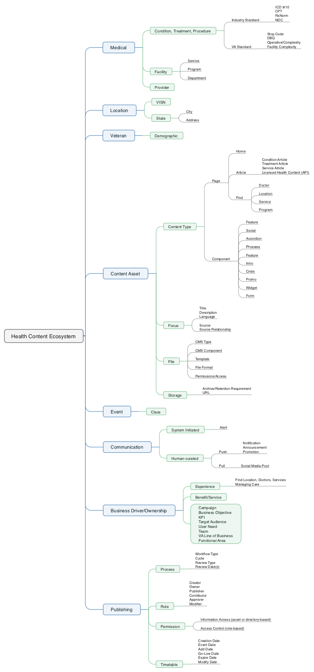
VA HEALTH CONTENT ECOSYSTEM

